Slide 1
Data Visualization Final Project “Analyzing Global Land Surface Temperature”
By: Shahryar Fazli
Instructor: Dr. Lindsay Waldrop
May 2023

Slide 2
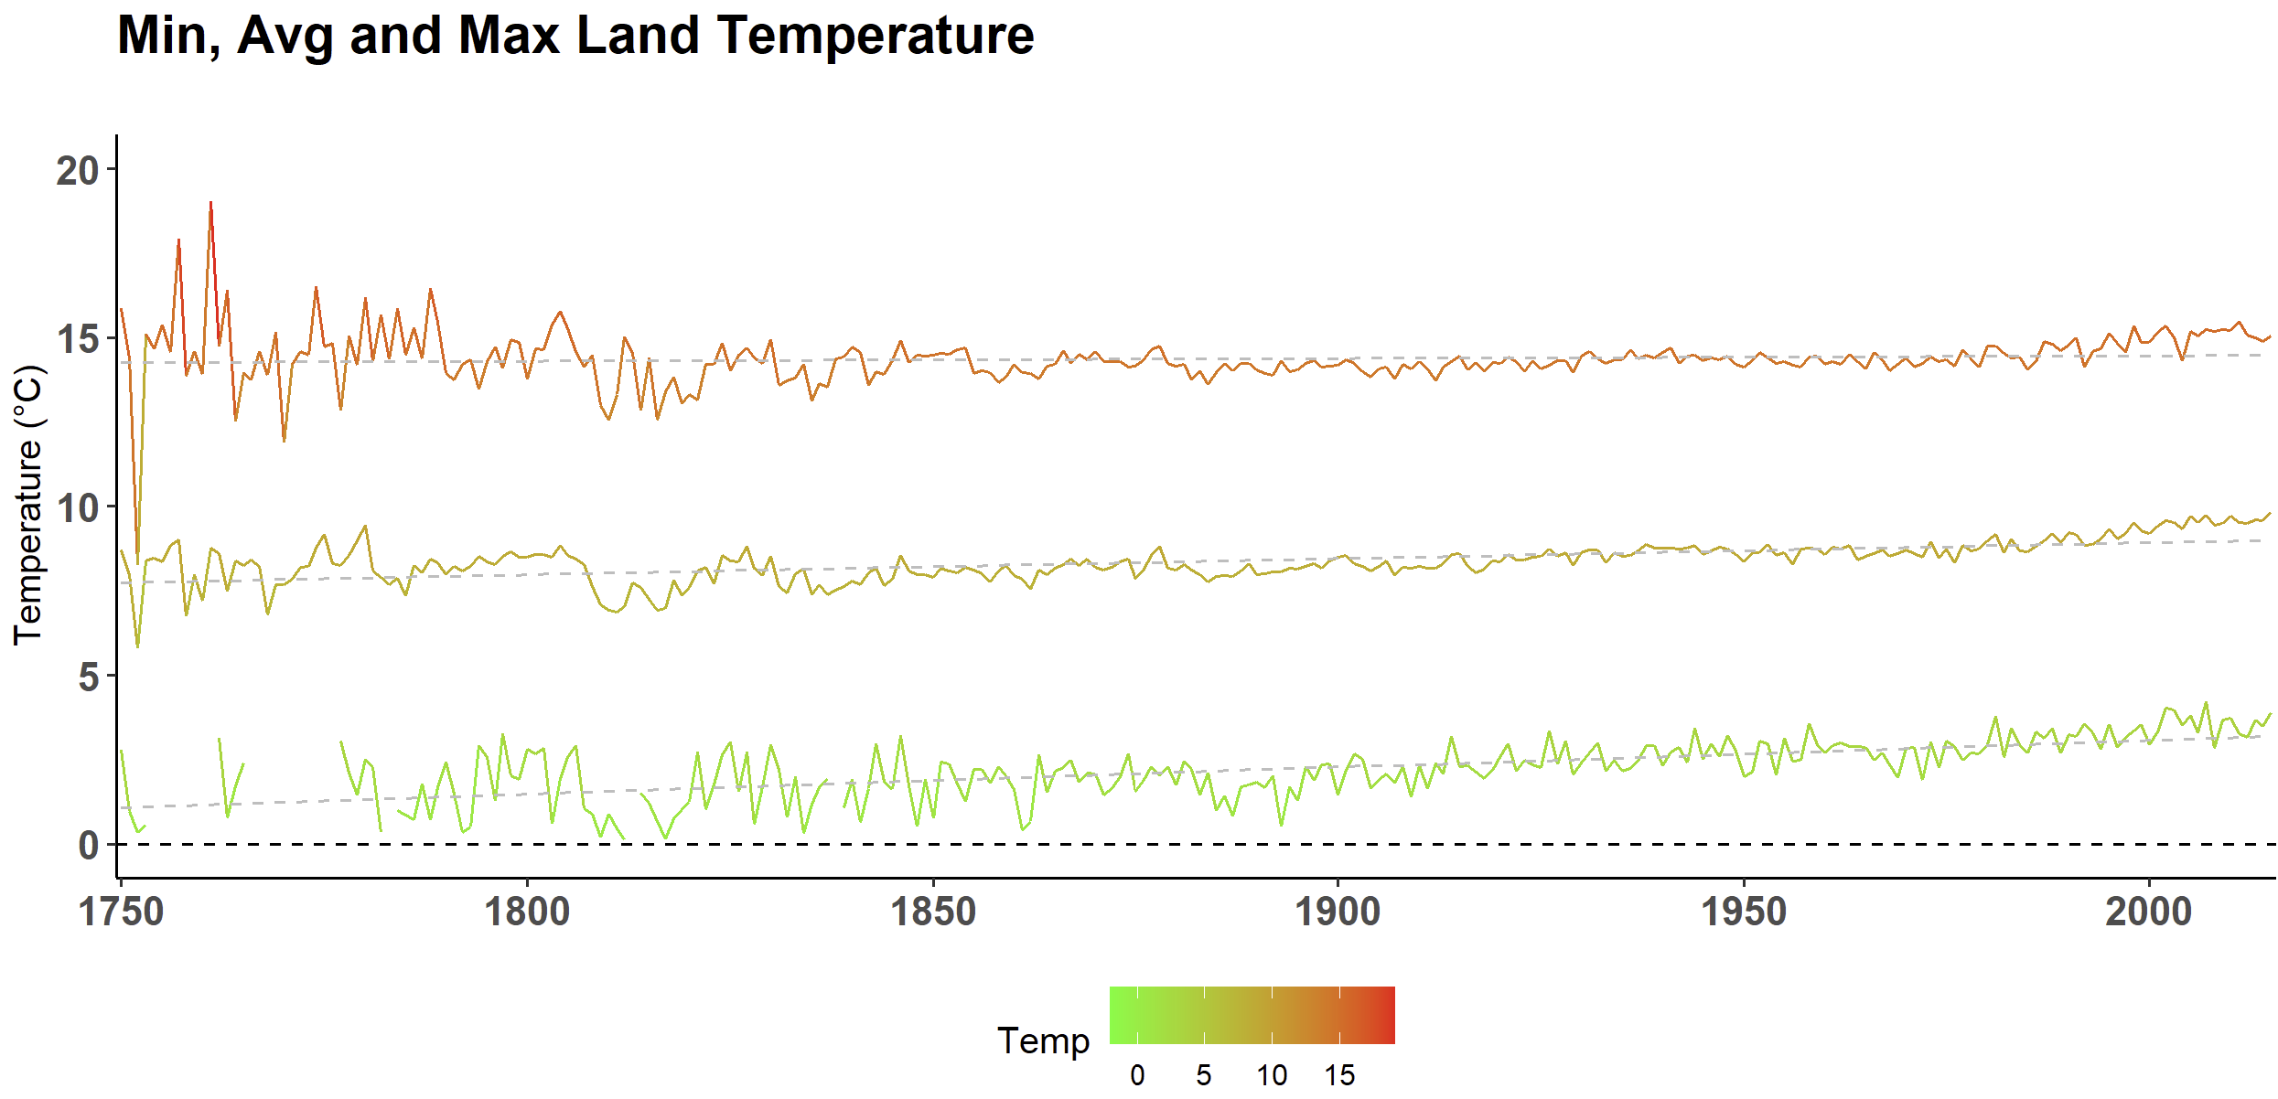
Annual Variation of Global Temperature

Slide 3
Seasonal Variation of Global Cities Temperature
Winter
Spring
Summer
Fall

Slide 4
Seasonal Variation of Global Cities Temperature
Summer

